Slide 1
CSE 2102: Introduction to Software Engineering
Software Production Process
Need for Process Models

Slide 2
Questions
What is the life cycle of a software product?
Why do we need software process models?
What are the goals of a software process and what makes it different from other industrial processes?

Slide 3
Software Production Process
Process taken to build, deliver and evolve a software product.
Focus: How do software engineers construct applications:
  Identification of an idea through its completion and maintenance
  To make production reliable, predictable, and efficient.
Hard to automate the software production process:
  Software production is a highly intellectual activity
  Software is characterized by high instability
  Involves interaction of individuals of various capabilities and backgrounds
  Requires interfacing with hardware, OSs, etc.
Production models attempt to capture the software life cycle.

Slide 4
Software Production Process (contd..)
Engineering disciplines have well-defined processes
For example, to build a house:
  Architect
  Engineer
  Contractor
  Subcontarctor
  Electrician
  Plumber
  …
All the steps are well-defined
Interface(s) between various steps are also known.
Can software have a similar, methodological approach?

Slide 5
Life Cycle of a Software Product
Life cycle consists of the time between the inception of an idea to the retirement of a product
Activities in the software life cycle
  Requirements analysis and gathering
  Architecture design and specification
  Coding and testing
  Delivery and deployment
  Maintenance and evolution
  Retirement

Slide 6
Software Process Model
Attempt to organize the software life cycle by
  Defining activities involved in software production
  Order of activities and their relationships
Goals of a software process
  Standardization, predictability, productivity, high product quality, ability to plan time and budget requirements

Slide 7
Code and Fix Model
Early software development model.
Programmers iterated between two activities:
  Writing code and subsequently fixing it.
Ad-hoc model caused many difficulties:
  Inherently deficient in its organization and discipline.
  No predictability.
Still in use.

Slide 8
Need for Models
Increase in the complexity of the applications:
Code and fix model worked when the user and the developers were the same:
  Eventually, separation between developers and end users.
New software applications had stringent requirements
More complex, with sophisticated requirements, and had to account for users with varying levels of expertise.
Implicit non functional requirements such as performance, reliability, robustness, maintainability.
Applications domains where failures could have significant consequences ranging from loss of property and life.
Complexity and scope of software applications reached beyond the scope of a single programmer.

Slide 9
Need for Models (contd..)
In summary, software development processes/software process models are needed to:
  Manage complexity in modern applications.
  Provide a detailed, careful analysis of user requirements.
Recall, these were essentially the same characteristics that we discussed were the driving catalysts for the need for software engineering principles.

Slide 10
Goals of a Software Process
Barry Boehm’s goals of a process model are to determine:
  Appropriate stages or phases in the development of a software application.
  When it is time to stop the activities in one phase, and to move to the next -- establish transition criteria for progressing from one stage to another.

Slide 11
Process as a Black box
Informal
Requirements
Process
Product

Slide 12
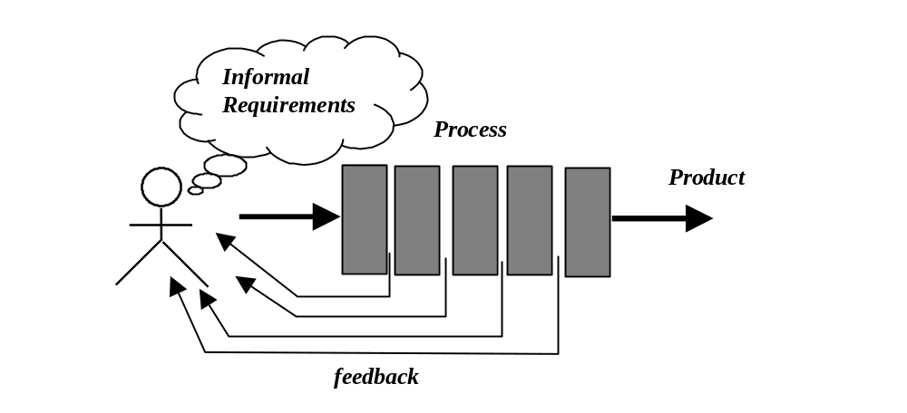
Process as a White box

Slide 13
Black-box vs. White-box Process View
Two complementary views of organizing a software process, differ based on:
  Visibility of the activities with the customer
  Level (frequency) of interaction with the customer.
  Black-box and White-box view.
Black-box view:
  Assumption -- Requirements can be fully understood prior to development.
  Interaction with the customer occurs only at the beginning (requirements) and at the end (after delivery).
  This assumption never holds.

Slide 14
Black-box vs. White-box Process View
White-box view:
  Interactions with the customer are allowed often.
  Allows the customer visibility into the system that is being built as it is being built, reduces risk by improving visibility.
  Customers can provide feedback during the project
  Goals of the project and the functions of the system can be revised based on this feedback.
Process as a white box appears to be a better approach than the process as a black box, however, there is always a risk of going too far.

Slide 15
Main Activities in Software Production
The main activities in the software production must be performed independently of the process model.
The process model simply affects the flow among the activities

Slide 16
Feasibility Study
Cost/benefits tradeoffs before initiating a new project
People: Customer, end user and developers
Contents highly dependent on the type of developer and application.
Requires to perform preliminary requirements analysis
Produces a Feasibility Study Document
  Definition of the problem
  Alternative solutions and their expected benefits
  Required resources, costs, and delivery dates in each proposed alternative solution
  Competing products

Slide 17
Feasibility Study (contd..)
For a commercial product:
  Prove/convince that the market exists
  Convince that the cost will be recovered
  Convince that the performance will be acceptable.
For a product to be used in-house
  Less stringent requirements
Customized software
  Satisfy the perceived need of the customer

